Slide 1
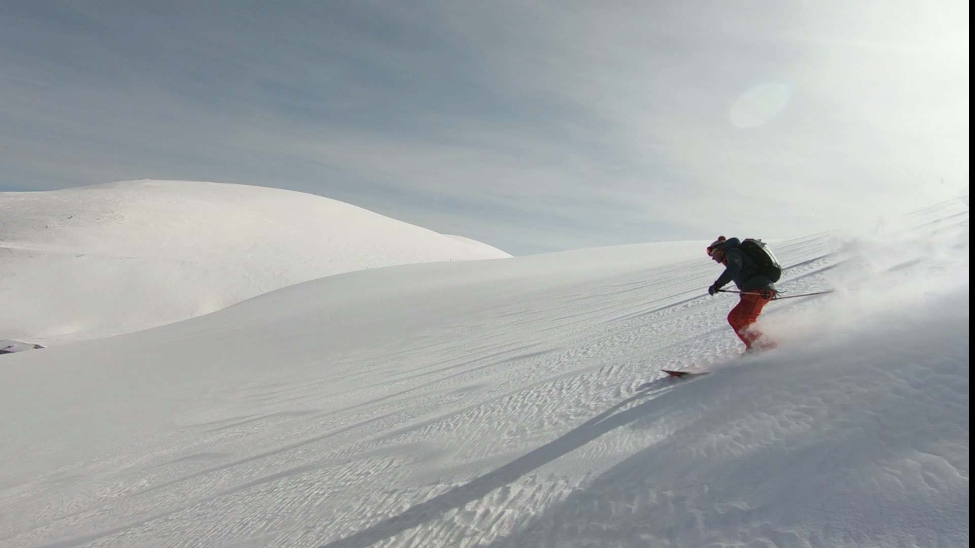
Big Mountain Ski Resort Data Science Project Executive Summary
Aysen Gungel Colak
05/20/2021

Slide 2
1.Problem Identification
The aim of the project was helping the Big Mountain Ski Resort in Montana to maintain or increase its profit margin by offsetting the newly added chair cost of $1.54M with a data-driven price strategy followed by an adjustment to the ticket prices.
The former pricing strategy before data science’s involvement was charging a premium above the average price of resorts in its ski resort market segment.

Slide 3

1.Problem Identification
This approach resulted in a suspicion that Big Mountain does not get advantage on its facilities as much as it could.
Positioning in the market average does not provide the business which facilities would add more value.

Slide 4
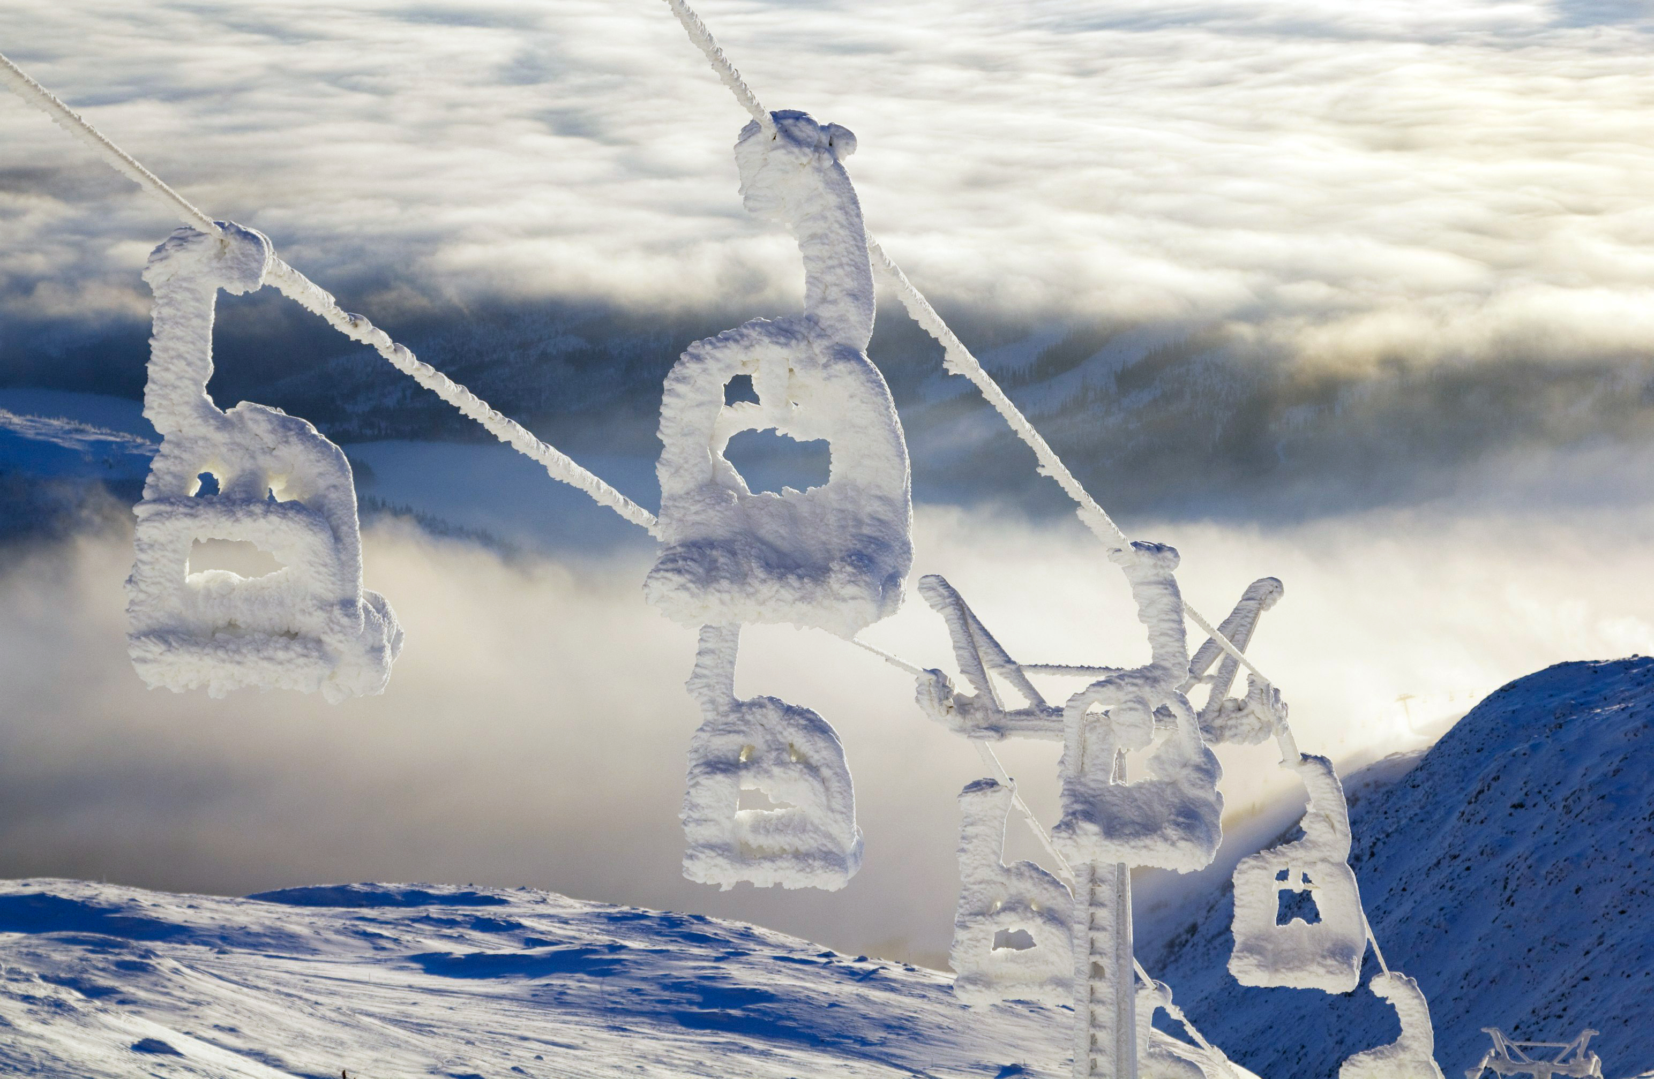
1.Problem Identification
A data-driven, analytical approach highlights a number of changes in facilities that will provide value by:
either cutting costs without reducing the ticket price or
supporting an even higher ticket price.

Slide 5
2.Recommendations and Key Findings
The features that emerged as significant to weekend adult ticket price are:
Vertical drop
Snow making
Total number of chairs
Number of fast quads
Runs
Longest run
Trams
Skiable Terrain

Slide 6
3. Modeling Results and Analysis
The linear regression model is based on the following scenarios:
Scenario 1: Permanently closing down up to 10 of the least used runs.
Scenario 2: Increase the vertical drop by adding a run to a point 150 feet lower down but requiring the installation of an additional chair lift to bring skiers back up, without additional snow making.
Scenario 3: Same as number 2 and 2 acres of snow making cover is added.
Scenario 4: Increase the longest run by 0.2 mile to boast 3.5 miles length, requiring an additional snow making coverage of 4 acres.

Slide 7
3. Modeling Results and Analysis
Scenario 1: Permanently closing down up to 10 of the least used runs.
The model says closing one run makes no difference. Closing 2 and 3 successively reduces support for ticket price and so revenue.
If Big Mountain closes down 3 runs, it seems they may as well close down 4 or 5 as there's no further loss in ticket price. Increasing the closures down to 6 or more leads to a large drop.

Slide 8
3. Modeling Results and Analysis
Scenario 2: Increase the vertical drop by adding a run to a point 150 feet lower down but requiring the installation of an additional chair lift to bring skiers back up, without additional snow making.
This scenario increases support for ticket price by $8.61.
Over the season, this could be expected to amount to $15065471.

Slide 9
3. Modeling Results and Analysis
Scenario 3: Increase the vertical drop by adding a run to a point 150 feet lower down but requiring the installation of an additional chair lift to bring skiers back up. Also, 2 acres of snow making cover is added.
This scenario increases support for ticket price by $9.90.
Over the season, this could be expected to amount to $17322717.

Slide 10
3. Modeling Results and Analysis
Scenario 4: Increase the longest run by 0.2 mile to boast 3.5 miles length, requiring an additional snow making coverage of 4 acres.
This model does not suggest any difference in ticket price.

Slide 11
4.Conclusion
The second and the third scenarios would make a significant difference in terms of value added.
However, decision makers should keep in mind that either solution would bring additional costs like:
Investment cost & maintenance(electricity, labor cost, insurance etc.)
Avoidance of risk of avalanches during operation and possible shutdowns
Time of delay in openings in case of wind, fog, avalanche or accident
Grooming machine’s extras like fuel, leasing, insurance, maintenance, staff depending on the degree of automation
Grooming cost per acre
Depreciation

Slide 12
THANK YOU!

